Slide 1
RainCheck: Will It Rain on My Parade?
Presented by:
Team AstroBytes

Slide 2

Introduction
RainCheck is a web-based project that predicts the chances of rainfall for a user-selected location, date, and time.
It integrates real-time weather data from the Visual Crossing API and displays humidity, rainfall forecast, and probability of rain to assist users in planning outdoor activities.

Slide 3
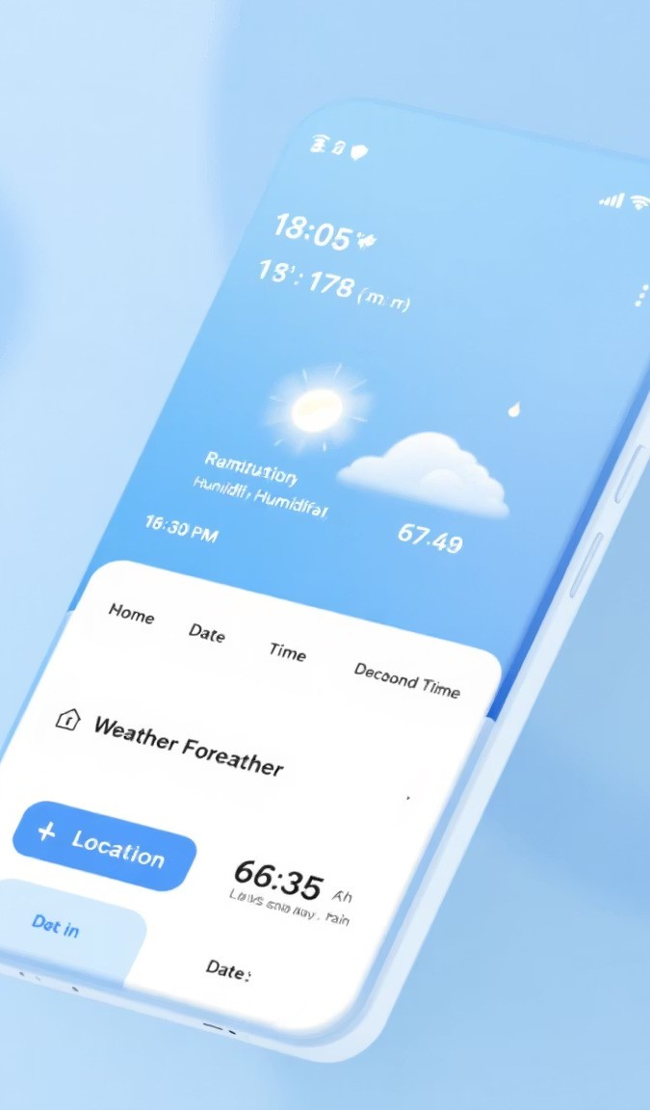
Key Features
Secure login system using HTML and JavaScript
User selects location, date, and time for prediction
Fetches real-time weather data from Visual Crossing API
Displays rainfall forecast, humidity, and rain probability
Interactive and responsive user interface with background visuals
Flask backend processes and returns JSON data to frontend

Slide 4
System Architecture
Frontend:
HTML, CSS, JavaScript for UI
Login page redirects to main prediction interface
Fetch API used to communicate with Flask backend
Backend (Flask):
REST API endpoint '/api/rain'
Processes latitude, longitude, and date inputs
Fetches weather data from Visual Crossing API
Calculates rain probability and forecast
Data Source:
Visual Crossing Weather API for real-time data

Slide 5
Workflow
Redirect to Main Page
After successful login, the user is redirected to the main prediction interface.
User Login
User logs in through the login page.
Retrieve Coordinates
Frontend retrieves geographical coordinates (latitude, longitude) using a Geocoding API.
Input Details
User enters location, date, and time for the weather prediction.
Display Results
JSON data from the API is processed by the backend and sent to the frontend. Rain probability, humidity, and forecast are then displayed to the user.
Backend API Call
The Flask backend calls the Visual Crossing API with the retrieved coordinates and date.

Slide 6
Technologies Used
Frontend: HTML5, CSS3, JavaScript (Vanilla JS)
Backend: Python Flask
API: Visual Crossing Weather API
Geocoding API: Open-Meteo Geocoding Service
Tools: Visual Studio Code, Browser Developer Tools " Data Format: JSON

Slide 7
Backend Logic (Flask)
Accepts latitude, longitude, and date as parameters
Makes API request to Visual Crossing with those inputs " Parses hourly forecast data for rain conditions"
Calculates rain probability based on hourly data
Returns JSON data with forecast rain (mm) and rain probability (%)

Slide 8
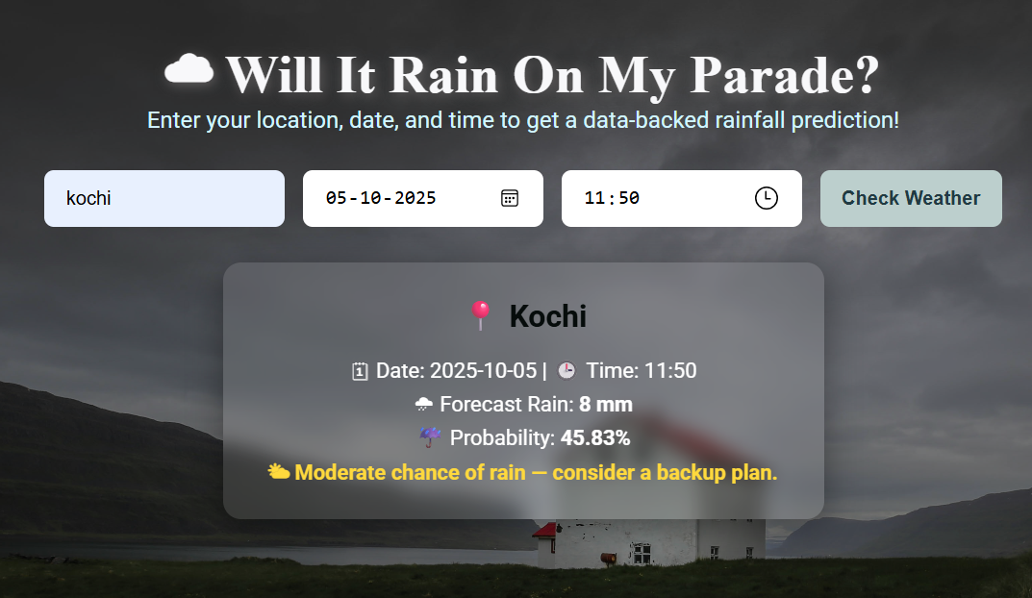
Results Display
Displays location, date, and time
Shows forecast rain (mm) and rain probability (%)
Color-coded risk level:
High risk Carry umbrella
Ÿ Moderate risk Consider backup plan
Low risk Ideal for outdoor activities
Simple visual cards and message feedback enhance clarity

Slide 9
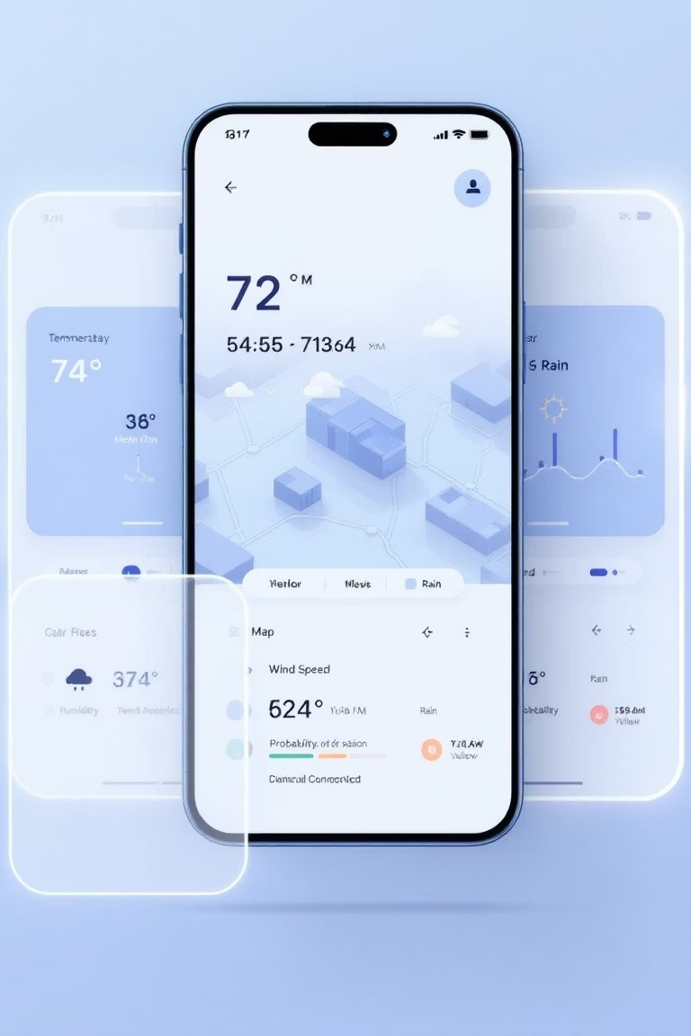
Future Enhancements
Integration of NASA GPM satellite data for improved precision
Addition of humidity visualization and hourly rain charts
AI model for multi-day rainfall prediction
SMS or email rain alert notifications

Slide 10
Conclusion
RainCheck provides an intuitive and efficient solution for predicting rain based on real-time data. With its login feature and interactive weather interface, users can make informed outdoor planning decisions while promoting climate awareness.

Slide 11
Thank You

